Slide 1
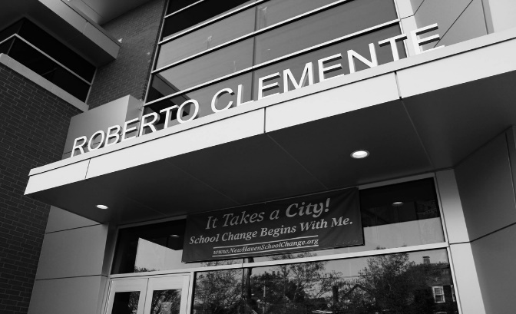
6th Grade News
Clemente Leadership Academy • 360 Columbus Avenue • New Haven, CT 06519
(475) 220-7600
September 2016
Vol. 1
Welcome Back
Bell Schedule
Agendas
8:30 School begins
8:40 Tardy bell
8:52 Homeroom ends
8:55 Block 1
10:24 Specials
11:13 Block 2
12:35 Lunch/recess
1:20 Block 3
2:45 Homeroom
2:50 Dismissal
Students will use their agendas to help stay organized with the expectations of their class work. Teachers will use them as a tool for communication with you. We ask that you check (and sign) agendas daily.
We are off to a strong start in 6th grade as students continue to navigate their way with learning the new bell schedule, the changing of classes, having 3 teachers and being “upstairs” for the first time! Their responsibilities have definitely increased from last year, and your children are rising to the challenge! We have high expectations for all students and we believe it is equally important that they too, develop high expectations of themselves. We also believe it is critical that we all work together to foster their emotional, intellectual, and social growth. We are looking forward to developing (and in some cases, continuing) a strong partnership with you so we can ensure both a successful and enriching year for your child. One of our goals as your child’s teacher is to exude passion and purpose for learning which we hope will be contagious.
We look forward to meeting you and sharing more at Open House, Tuesday, September 27th from 6-8pm! In the meantime, please don’t hesitate to call any one of us if you have any concerns or questions!
Uniforms
Attendance
Black, collared shirt
Khaki pants/skirt
Students will need their gym uniforms on their scheduled day.
It is so important that your child attend school every day. In the event that they must miss a day, please send them with an note the next day.
New Tardy Policy
1st Tardy – First warning by homeroom teacher.
2nd Tardy – Final Warning by homeroom teacher.
3rd Tardy – Phone call home and detention.
4th Tardy – Referral
5th Tardy – Parent/ Guardian must attend a mandatory conference with administrators. .
Dates to Remember!
“…..I will always be prepared to do my best to learn….”
9/16 – 21st Century Barbeque
9/23 – Book Fair begins
9/27 – Open House
9/28 – Volleyball Incentive
9/29 – Character Ed Assembly – RESPONSIBILITY

Slide 2
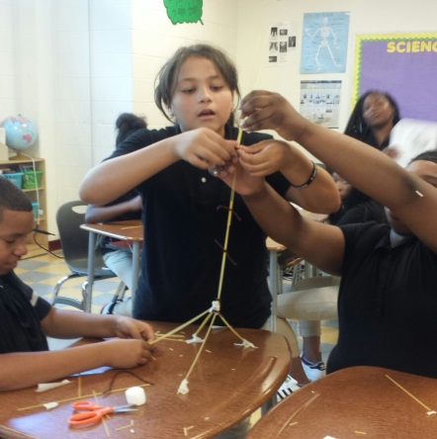
I want to welcome students and parents alike to a new school year! I am excited to be working with your child. I have been at Clemente for six years, so many faces are familiar. We are starting this year with a lot of enthusiasm and many new ideas to enhance curriculum. One goal is that our students see education as a continuous process and that all their classes connect in one way or another. Specifically in ELA (reading and writing) we will be reading our Core Novel titled The Skin I’m In by Sharon G.Flake. Over the course of the marking period we will be reading for meaning, looking at the authors craft and the importance of character development. For our writing piece, we will be focusing on completing a personal narrative by the end of the quarter.
Literacy
Classroom News
Ms. Bonilla
Nancy.Bonilla@new-haven.k12.ct.us
Homework is an essential piece to student success and an extension of the learning going on in the classroom.
Please encourage your child to complete assignments.
We have a lot of work to do and every child has the ability to succeed, we just all need to band together and make it happen!!!!
First Quarter
September 2016
Math
In math, students have been working hard to problem solve and push through Unit 1 – Number Concepts of the Spring Board Textbook. In this unit, students extend their understanding of addition, subtraction, multiplication and division of whole numbers, decimals and fractions and apply their knowledge to solve problems. They study multiples, factors, and exponents and compare and order rational numbers. Students are using online resources like Gizmo, Khan Academy, and Reflex Math to increase their skills. Parents, please encourage your child to do homework every day.
Ms. Dalsania
Chandani.Dalsania@new-haven.k12.ct.us
I am so excited to be teaching both Science and Social Studies
to this inquisitive group of 6th graders this year! Between the upcoming Presidential election and the ever growing interest in the field of science, there is so much to be inspired about!
In Science, students are learning how to hypothesize and
Investigate scientific problems. We will continue to question, observe, record and conduct experiments
Science & Social Studies
Ms. Dahlin
Christine.Dahlin@new-haven.k12.ct.us
as we learn more about ecosystems and the effects of pollution. I encourage students to observe their everyday lives and surroundings and question “what if” and “I wonder how”…..
In Social Studies, students are exploring the relationship between their Identity and a Community. What does our Identity mean to us, how is it created and how does it fit into our community at school, at home, our city, and beyond?
As our understanding develops, we will continue to examine the rights of citizens in a democratic society.
20 pieces of spaghetti
1 yard of tape
1 yard of string
1 marshmallow
Students worked in teams of 4 in their quest to build the tallest, freestanding structure in 20 minutes!
Amazing collaboration at work!

